Slide 1


License Monitoring and Auditing with PowerShell and Power Platform
Danny Davis, Tatjana Davis

Slide 3
AGENDA SLIDE
WRITE YOUR SUBTITLE HERE
1
4
Introduction
Monitoring. How?
01
04
About us and collabonists
What are out-of-the-box features and limitations?
2
5
Group-based licensing. What?
PowerShell & Power Platform
02
05
Green marketing is a practice whereby companies seek to go above and beyond.
The dynamic duo will bring order to the chaos.
3
6
Monitoring. Why?
Demo & questions
03
06
Why should you implement a monitoring solution and why you should really, really use it.
A demo with some out-of-the-box features and maybe some questions.

Slide 4
Introduction collabonists
Chapter 1

Slide 5




About us
Founded 2019
2 full time, 1 part time and 1 trainee
Based in Rehau (Germany)
Focused on Microsoft Technology Consulting

Slide 6






Danny Davis
Lead Consultant / Architect
dd@collabonists.io
Founder & Owner
collabonists UG (haftungsbeschr.)
collaboREX GmbH
What’s my job?
A lot of meetings, architecture, some PowerShell and a lot more meetings

Slide 7


Tatjana Davis
Developer / Consultant
td@collabonists.io
What’s my job?
Creating technical designs and concepts
Power Apps/Power Automate
PowerShell
SharePoint
Microsoft Certified: Power Platform Developer Associate

Slide 8
Group-based licensing. What?
Chapter 2

Slide 9
Group-based licensing
Group “collab features”
Group “EXO features”
Usually SharePoint Online, Teams, OneDrive and other collaboration features
Features like Exchange Online, Bookings.
Group “PowerApps Premium”
Group “Azure AD Plan 2”
An example for optional licenses
An example for optional licenses

Slide 10
License Assignment Process
01
User joins the company
Account gets created and synced to the cloud
02
First license assignment
03
Create an on-premise mailbox
a license for collab features will get assigned
Create mailbox on-premise, sync to the cloud and assign a license for Exchange Online
04
User is fully enabled
User can now work with all the available tools
Notes:
01 – This will usually contain the collab features like SPO, OneDrive & Teams
02 – in hybrid environments a mailbox needs to be created on premise, a license will be assigned in the cloud. The remote mailbox is needed, so that all attributes can be modified, which is only possible on premise.

Slide 11
Monitoring. Why?
Chapter 3

Slide 12
Why is license monitoring important?
Clean up unused licenses
Depending on the user life cycle, some licenses will be assigned for a long time to keep the user data.
Get an overview of license usage
It is important to know, who is using your licenses.
Offsetting costs
Offset costs by usage. Bill your departments & subsidiaries to enforce user clean ups.
Forecasting
Based on historical data, you should do forecasts for onboarding and ordering licenses.
Notes:
Get an overview of license usage – in larger environments, licenses are assigned by subsidiaries or departments, therefore license groups are created with this structure in mind.

Slide 13
Monitoring. How?
Chapter 4

Slide 14
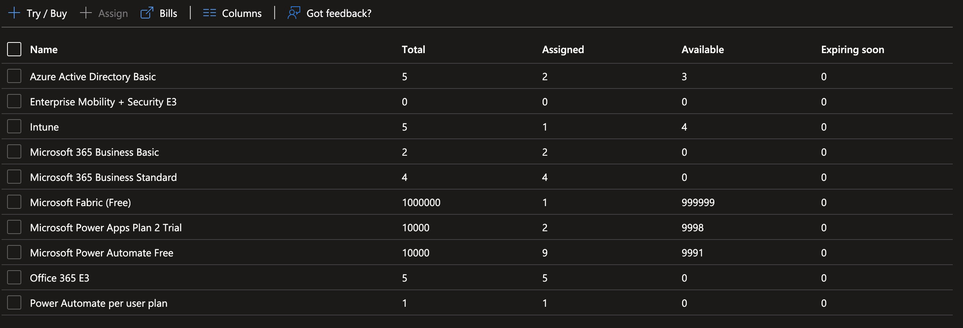
Out-of-the-box features in Azure
Azure
Select “Azure Active Directory” (“Entra ID”)
Select “Licenses”
Select “All Products”
Notes:
Get an overview of license usage – in larger environments, licenses are assigned by subsidiaries or departments, therefore license groups are created with this structure in mind.

Slide 15
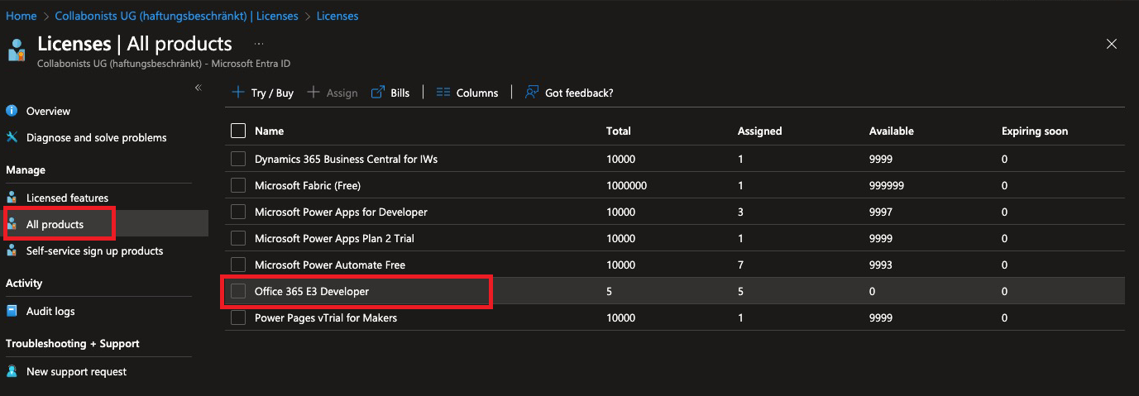
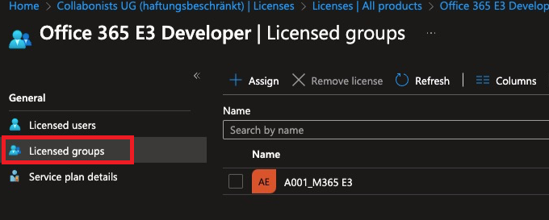
Out-of-the-box features in Azure
Azure
Select “Azure Active Directory” (“Entra ID”)
Select “Licenses”
Select “All Products”
Notes:
Get an overview of license usage – in larger environments, licenses are assigned by subsidiaries or departments, therefore license groups are created with this structure in mind.

Slide 16
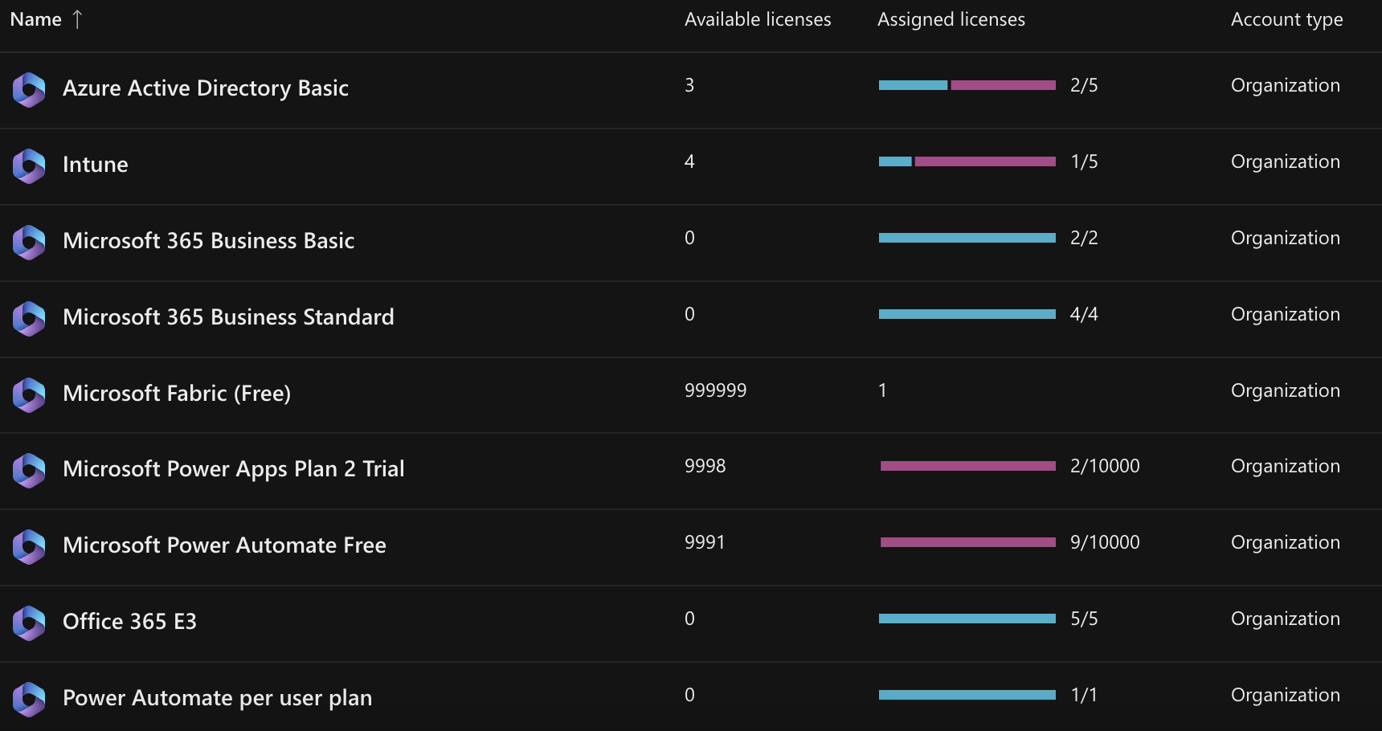
Out-of-the-box features in Microsoft 365
Office/Microsoft 365 Admin Center
Select “Billing”
Select “Licenses”
Notes:
Get an overview of license usage – in larger environments, licenses are assigned by subsidiaries or departments, therefore license groups are created with this structure in mind.

Slide 17
PowerShell & Power Platform
Chapter 5

Slide 18
How to get your monitoring management-ready?
Identify
Gather Data
Transform Data
Present Data
Identify your needs and your license groups
Gather your data from Azure AD and store it in an accessible location
Transform your gathered data for easier handling
Display your data in PowerApps / PowerBI
Notes:
Get an overview of license usage – in larger environments, licenses are assigned by subsidiaries or departments, therefore license groups are created with this structure in mind.

Slide 19
Where can you find your data sources?
Licenses in Azure AD
License groups
Additional attributes
Identify which licenses you want to keep an eye on. Ideally: all of them.
Identify impacted license groups.
Identify additional attributes, like department or office.
Create a couple of mapping lists.
Notes:
Get an overview of license usage – in larger environments, licenses are assigned by subsidiaries or departments, therefore license groups are created with this structure in mind.

Slide 20

Gather Data
Prepare all mapping lists, contents
License Types
License groups
Additional Attributes
Get to coding
Structure your script before you start coding
Document your code!
Collect all the data
Store data in an accessible location
Smaller companies: SharePoint
Enterprise environments: Dataverse, Azure SQL Database

Slide 21
PowerShell – Gather data
Start
Store license group data in SharePoint
Connect to MS Graph
Read information from SharePoint
Read license information from Azure AD
Store license type data in SharePoint
Connect to PnP
Store tenant-wide license data in SharePoint

Slide 22
PowerShell
Modules:
PnP Online: Read and write data from/to SharePoint
Microsoft Graph (or Azure AD): Read data from Azure
Get-MgGroup (Get-AzureADGroup)
Get-MgGroupMembers (Get-AzureADGroupMember)
Get-MgSubscribedSku (Get-AzureADSubscribedSKU)
Assigned licenses: ConsumedUnits
Total available licenses: PrepaidUnits.Enabled

Slide 23



Transform Data
Power Apps
Power BI
Power Automate
Power BI Desktop
Flow processes data whenever a SharePoint list item is created
Transform data in desktop client and store dataset in workspace

Slide 24
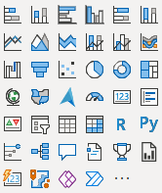

Comparison Power Apps / Power BI
Premium license required to share reports with other people
Standard features can be used with M365 licenses
Many data storage options (but many require Premium licenses)
Many data storage options (without further license cost)
Power
Apps
Power
BI
Column charts, line charts, pie charts
Countless visuals
Limited capabilities to export data
Data can be easily exported

Slide 25
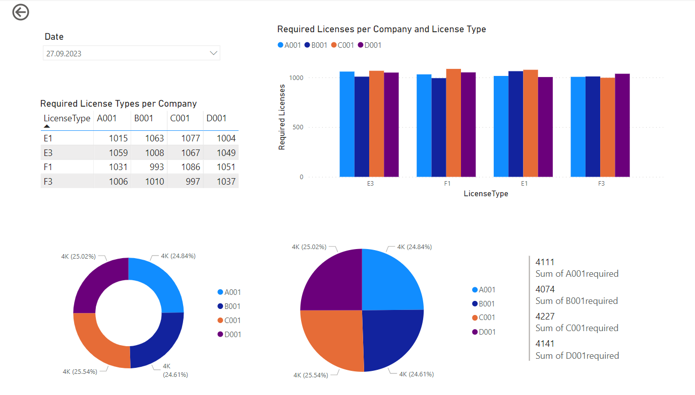
Present Data in Power BI

Slide 26
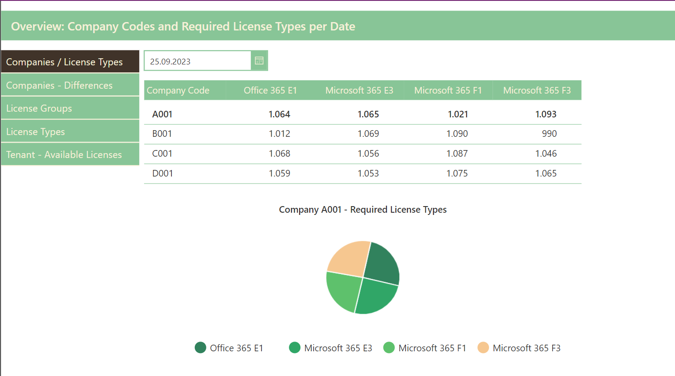
Present Data in Power Apps

Slide 27
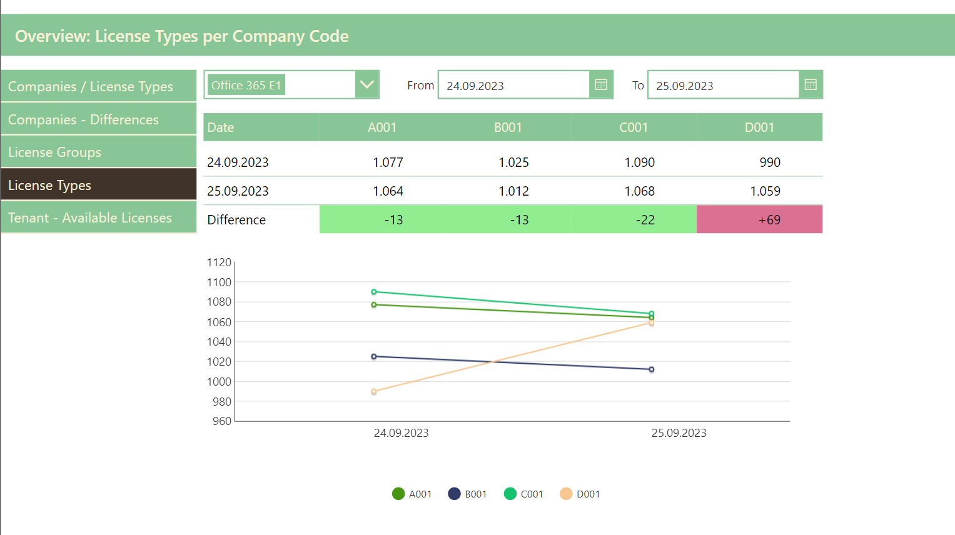
Present Data in Power Apps

Slide 28
You’re ready!
Good job!
Your management can work with an easy–to-use UI and can make informed decisions

Slide 29
Demo
Chapter 6

Slide 30
Demo Tenant Structure
4 Company Codes
16 Groups
A001
B001
C001
D001
A001_O365 E1
A001_M365 E3
…
D001_M365 F3
4 License Types
Office 365 E1
Microsoft 365 E3
Microsoft 365 F1
Microsoft 365 F3

Slide 31




Demo Tenant Structure
show data
to users
once
per day
transform data and store it in SharePoint
when a list
item is created

Slide 32
Demo
Power Apps
Power BI

Slide 33
Questions
Chapter 7

Slide 34
Links
Github: https://github.com/collabonists/CollabDays2023
LinkedIn: https://www.linkedin.com/company/collabonists/
Website: https://www.collabonists.io/

Slide 35
Thank You!

